Slide 1
Personal UPI Usage and Financial Analyzer using LLMs
Avalan R

Slide 2
Develop an AI-powered application that:
Processes UPI statements from multiple platforms.
Extracts and cleans transaction data from PDFs
Analyzes financial behaviour
Provides actionable insights using LLms

Slide 3
BUSINESS USE CASES
1. Personal Finance Management
2. Spending Habit Detection
3. Budgeting Assistant with Alerts
4. Multi-App Integration

Slide 4
Skills Gained
PDF Data Extraction & Parsing
Data Cleaning and Structuring
Financial Data Analysis
Langflow and LLM Chaining
Gradio/Streamlit Deployment
Hugging Face Space Integration

Slide 5
System Architecture / Flow
Upload PDF
Extract and Clean Data
Categorize Transactions
Analyze Patterns And Trends
Generate LLM-Based Recommendations
Display in UI (Gradio/Streamli)

Slide 6
Tools and Technologies
Python
pandas, pdfplumber, openAI, Hugging Face LLms
Langflow ( for chaining models )
Gradio/Streamlit UI
Hugging Face Spaces ( Deployment )

Slide 7
PDF Parsing & Cleaning ( clean1.py, extract.py)
  Used pdfplumber for structured extraction
  Removed invalid rows, parsed dates
  Standardized currency formats
  Output: cleaned_statement.csv

Slide 8
Data Structuring & Categorization ( process.py )
Convert to floats & datetime
Created YearMonth column
Categorized Remarks using keyword-based rules
Output: Clean & categorized DataFrame

Slide 9
Financial Analysis (clean2.py, analyze.py)
Monthly Debit & Credit Summary
Top Merchants / Payees
Average Balance Calculation
Output: Summary string for LLm

Slide 10
LLM Integration ( hugface1.py, call_llm.py )
Prompted Falcon-7B with financial summaries
Generated personalized advice
API-driven integration using gradio_client
Future Ready for OpenAI / Langchain

Slide 11
Deployment ( app.py )
  User uploads PDF, enters password
  App extracts, analyzes, and summarizes data
  Hosted on Hugging Face Spaces using Gradio
  Future scope : Add charts, visualization

Slide 12
Challenges Faced
UPI Statements had inconsistent layouts, Handling encrypted PDFs securely was tricky
Remarks and amounts were often unstructured
No clear Labels in data – required manual rule based categorization.
Designing effective prompts for meaningful financial advice was challenging

Slide 13
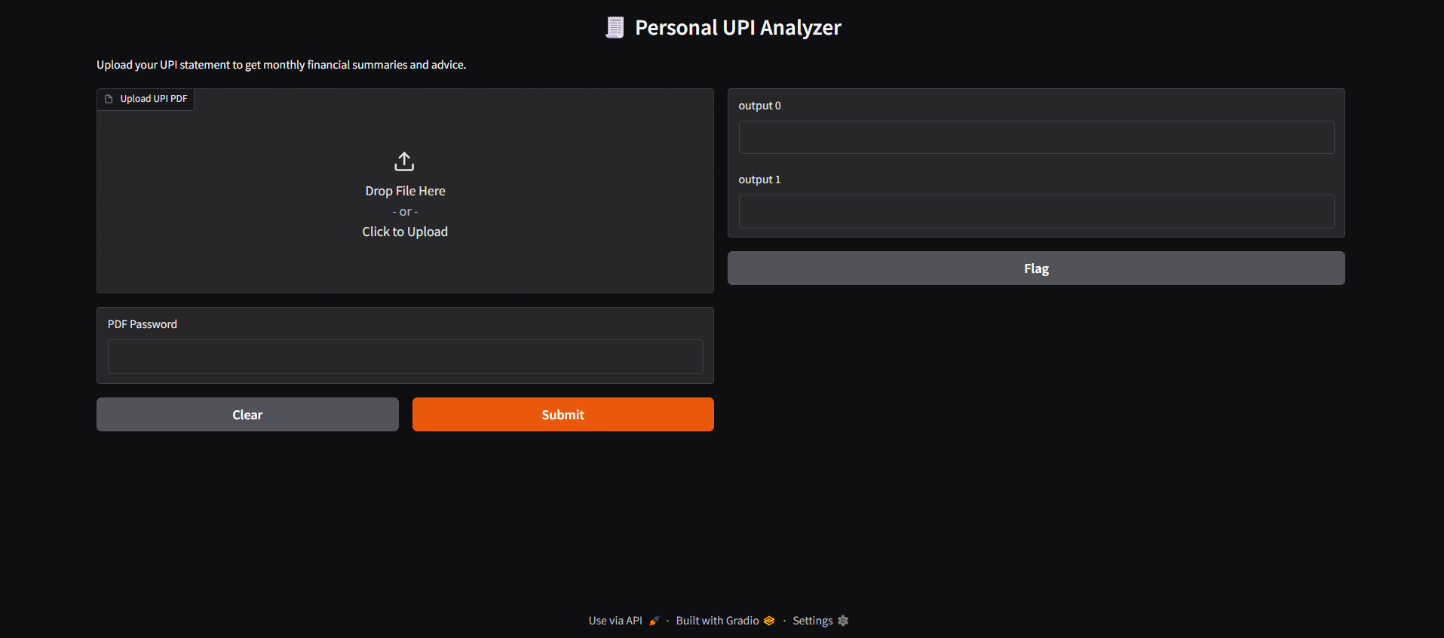
Output

Slide 14
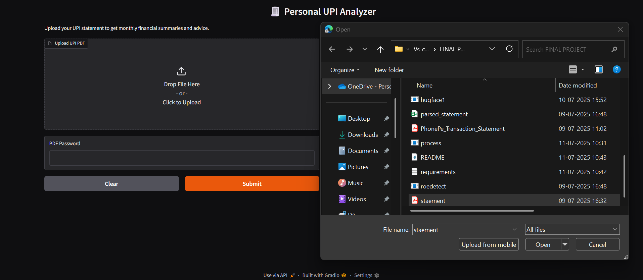
Output

Slide 15
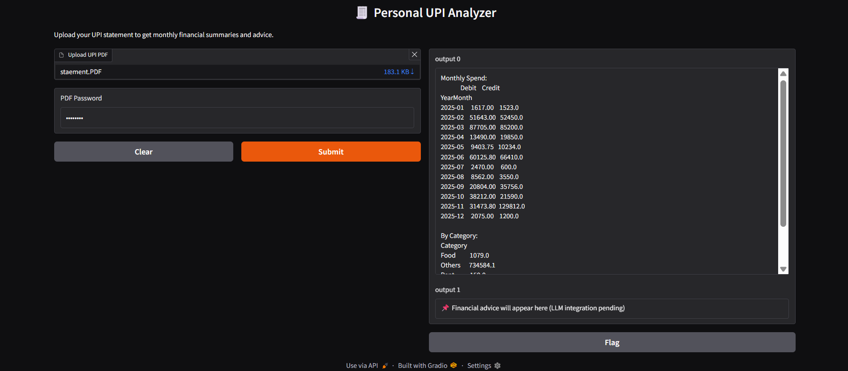
Output

Slide 16
Results & Impact
Personalized UPI Analyzer Working
Real-time insights via LLM
Budgeting & Savings suggestions
Empowers users to make informed decision

Slide 17
THANK YOU

